Slide 1
INFANT MENTAL HEALTH AWARENESS WEEK 2022
BIRTH TRAUMA:
what can we do?
RACHEL FRASER
CONSULTANT PERINATAL PSYCHOLOGIST

Slide 2
TRAUMA TREATMENT
PHASED-BASED TREATMENT
safety &
stabilisation
What is safety & stabilisation?
Support to care for the self,
Create and repair connections to and trust in other human beings
Regain a bit of faith in the universe.
trauma processing/ therapy
And with a new baby??
Working in 3rd sector and support is a golden opportunity to do Phase I (and 3) work
reintegration

Slide 3
IT'S GOOD TO TALK... SOMETIMES! what to start with
adapted from makebithbetter.com with thanks
Acknowledge their distress (never use the phrase "at least"! Don't point out that the outcome ended ok "but look the baby is fine!")
Let them talk but don't ask them to
Help think through the basics: eat, sleep, play, connect
Contribute to a sense of safety by creating opportunities to rest
Help the person to feel ‘mothered’ but not ‘smothered’
Offer written material on emotional wellbeing in the postnatal period and signpost to any available support services
Check how their partner is doing
If you are worried, contact HV, GP etc- the worry can be about mum/ birthing person, dad/ second parent, baby or about these relationships

Slide 4
connection
What does your service offer which helps mum/ birthing person connect with baby? With peers? With the community?
With life?
Don't assume anything, everyone is different!
What usually (before birth) brought this particular mum
-
- joy
- soothing
- connection
- calm?

Slide 5
grounding: if someone is re-experiencing
A crucial element of Phase I trauma work
Activity which returns us to the here and now (where our brains are tricking us that the trauma is recurring/ threat present)
-
regulation (e.g temperature, heart rate etc)
here & now
safety
switches back on reflective/ thinking brain

Slide 6
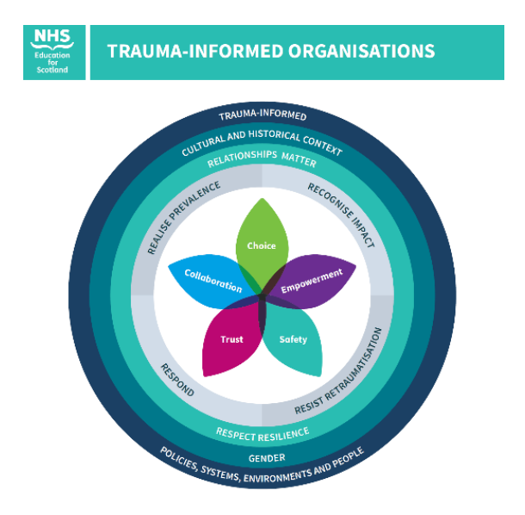
do what you always do... in a trauma-informed way
CHOICE
EMPOWERMENT
SAFETY
TRUST
COLLABORATION

Slide 7
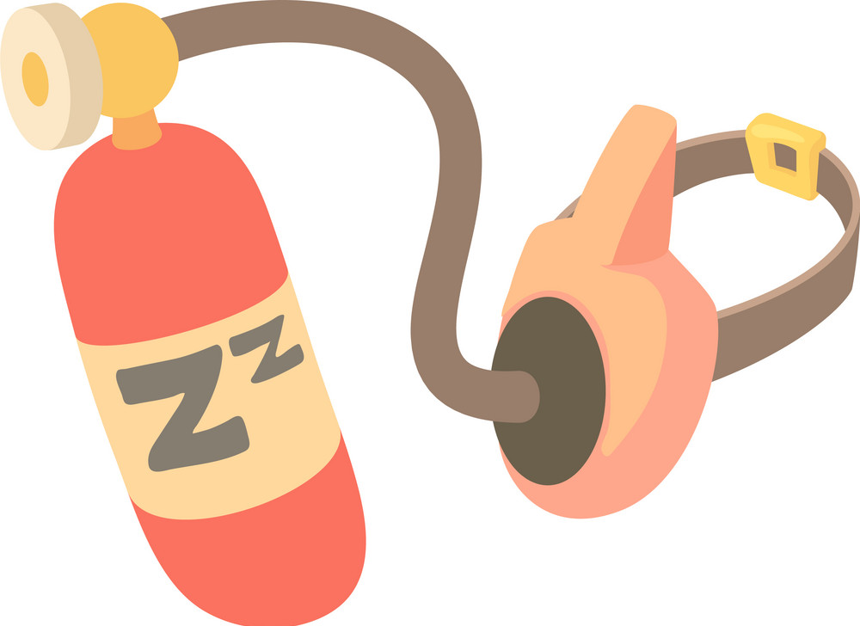
LOOK AFTER YOURSELF!!!
- connection
- places to talk through
- grounding
- taking time to process
- being realistic
- what brings joy, relief etc

Slide 8
links
resources:
www.makebithbetter.org
https://www.nes.scot.nhs.uk/our-work/trauma-national-trauma-training-programme
https://www.psychologytools.com/resource/grounding-techniques/
Your local NHS services are growing:
MNPI (Matenity & Neonatology Psychological Interventions)
PMH (Perinatal MH)
IMH (Infant/ Parent-Infant MH)

